Slide 1


Nhat Doan Process models and Agile Development
CSC131 Software Engineering

Slide 2
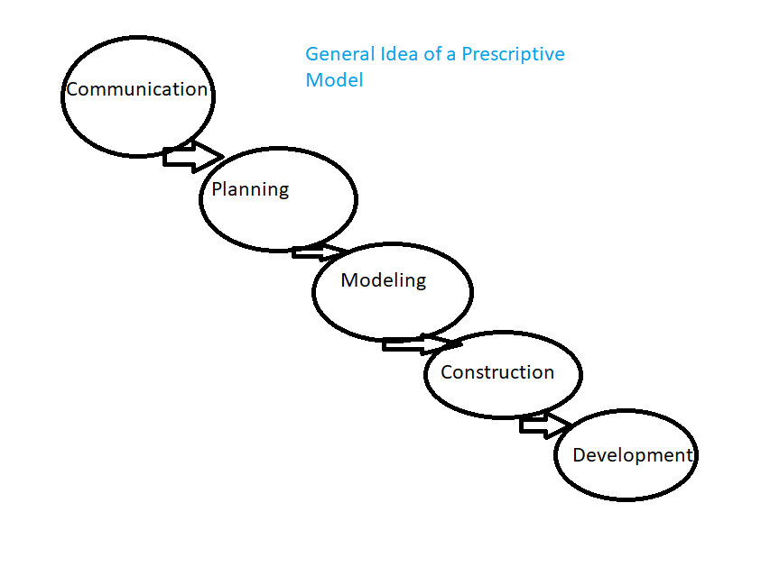
Prescriptive Models

Slide 3
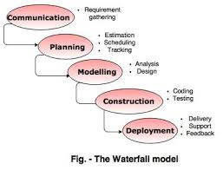
Waterfall model
It a linear path of process where between the parts, there are steps that are required
https://www.tutorialride.com/software-engineering/prescriptive-process-models.htm

Slide 4
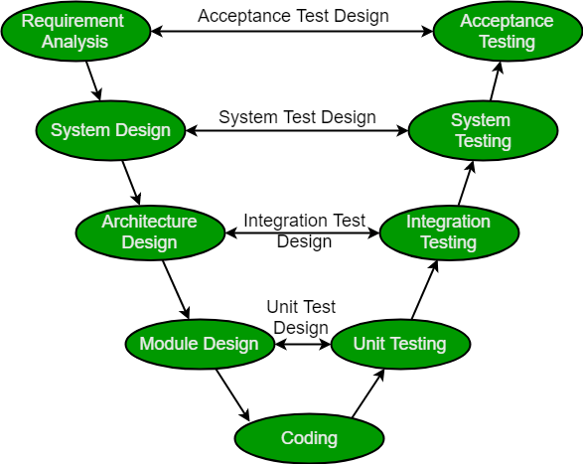
V Model
V model is more for high skill developers. The planning is spread out to the who process after each layer is executed. There are also testing and maintenance after finishing coding.
https://www.geeksforgeeks.org/software-engineering-sdlc-v-model/

Slide 5
The Incremental Model
It is really similar to water fall model, but there are updates to be occurred after delivery of any product.

Slide 6
Evolutionary Models:prototyping
This is the combination of water fall and incremental models, but the planning and design seems to be merged in one process.
There are also updates applied to get the product become better

Slide 7
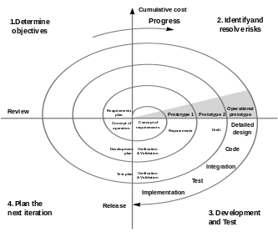
Evolutionary Model: The Spiral
It is similar to incremental model, but more emphasize placed on risk analysis
https://en.wikipedia.org/wiki/Spiral_model

Slide 8
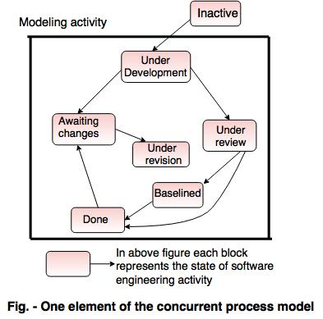
Concurrent
Different parts of a project will be performed at different place concurrently in the process
https://www.tutorialride.com/software-engineering/evolutionary-process-models-in-software-engineering.htm

Slide 9
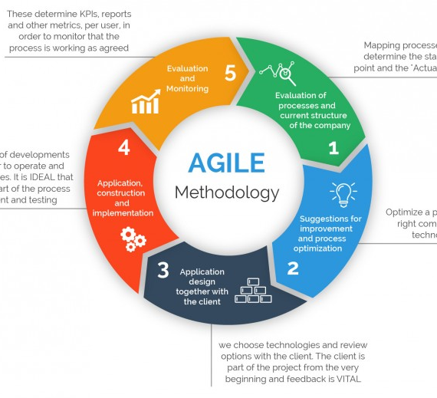
Agile Methodology
Scrum
Exteme Progamming XP
Adaptive Software Development
DSDM
https://www.360logica.com/blog/the-importance-of-different-agile-methodologies-included-in-agile-manifesto/

Slide 10
Adaptive Software Development
Focused on the end users, which can lead to better and more intuitive products
Allows for on-time and even early delivery
Encourages more transparency between developers and clients
https://www.productplan.com/glossary/adaptive-software-development/

Slide 11
Extreme Programming (XP)
Simplicity is increased

Slide 12
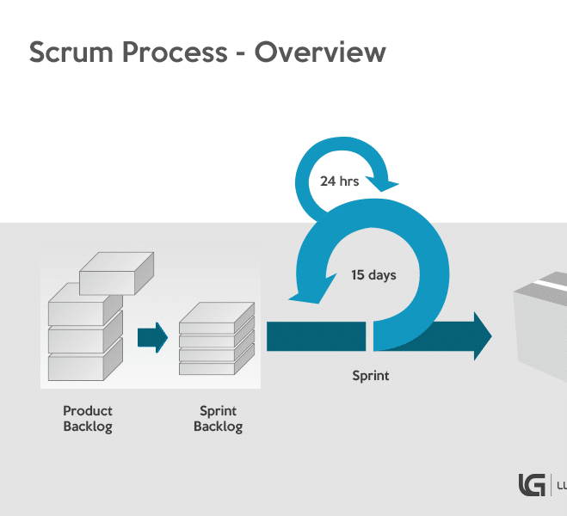
Scrum
Scrum can help teams complete project deliverables quickly and efficiently
Scrum ensures effective use of time and money
Large projects are divided into easily manageable sprints
Developments are coded and tested during the sprint review
Works well for fast-moving development projects
The team gets clear visibility through scrum meetings
Scrum, being agile, adopts feedback from customers and stakeholders
Short sprints enable changes based on feedback a lot more easily
The individual effort of each team member is visible during daily scrum meetings
https://luis-goncalves.com/what-is-scrum-methodology/

